Slide 1



Dynamic Traffic control system using Internet of things
TEAM MEMBERS:
SURYAA K S (210701273)
SYED JAVITH R (210701278)

Slide 2


Agenda
01
02
03
04
05
06
Abstract
Objective
Literacture
survey
Introduction
Proposed System
Existing System
07
08
09
10
Modules
References
System Architecture
Future Enhancement

Slide 3
Abstract
In urban areas, traffic congestion remains a persistent challenge, leading to increased travel times, fuel consumption, and environmental pollution. Traditional traffic control systems rely on fixed-time signals, often resulting in inefficient use of road capacity and unnecessary delays for public. To address these issues, we propose a Dynamic Traffic Control System using IoT technology and IR sensors for real-time traffic monitoring and signal adjustment . It employs IR sensors placed along roadways to detect the presence of vehicles. Using this data, the system dynamically adjusts traffic signal timings to prioritize roads with higher vehicle density, effectively optimizing traffic flow and reducing congestion. When a buildup of vehicles occurs on one side of an intersection, the system responds by clearing that direction with a green signal while signaling red for other directions, ensuring efficient traffic movement. Furthermore , it adapts to changing traffic conditions by continuously monitoring vehicle density and adjusting signal timings accordingly. This dynamic approach minimizes unnecessary wait times at traffic signals, improving overall traffic efficiency and enhancing the driving experience for commuters .

Slide 4
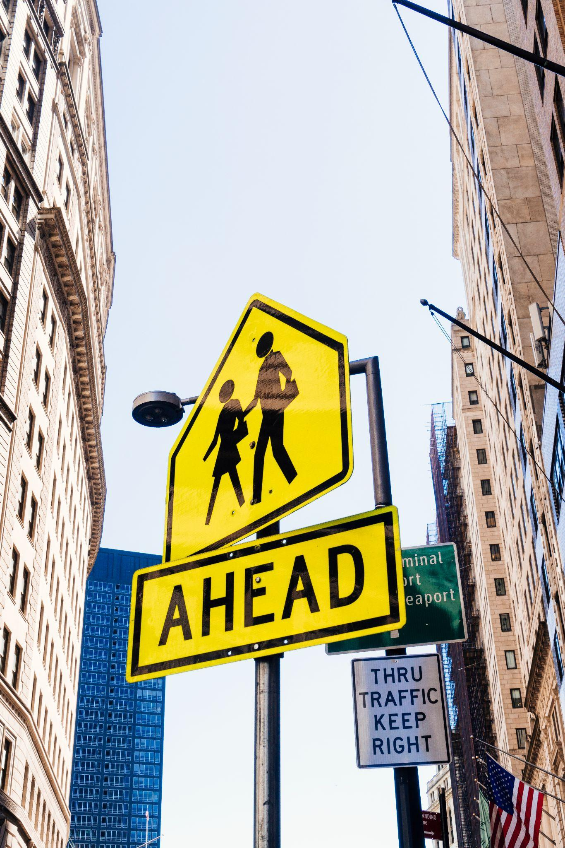
Introduction
Urbanization has led to significant challenges for transportation authorities in managing congestion and ensuring smooth traffic flow. Traditional traffic control systems, with their static and predetermined signal timings, often prove inadequate in adapting to the dynamic nature of traffic patterns, resulting in inefficiencies and increased travel times for public. In response to these challenges, this project introduces a novel approach to traffic management through the development and implementation of a Dynamic Traffic Control System .
The heart of the project lies the integration of Infrared (IR) sensors strategically deployed along roadways to detect the presence and movement of vehicles in real-time. Unlike conventional systems, which rely on predetermined signal cycles, our project utilizes this continuous stream of data to dynamically adjust traffic signal timings based on the prevailing traffic conditions. By dynamically allocating green signal time to congested routes while efficiently managing traffic flow in other directions, the DTCS aims to minimize delays and improve overall travel efficiency. In addition to its responsiveness, it offers scalability and cost-effectiveness, making it a viable solution for urban traffic management in diverse settings.

Slide 5

Objective
To enable real-time monitoring of vehicle presence and movement on roadways using IR sensors.
To reduce congestion and minimize travel times for people through responsive traffic signal adjustments.
To demonstrate the scalability and cost-effectiveness of the project for urban traffic management applications.
To contribute to the advancement of smarter and more sustainable transportation solutions for urban environments.

Slide 6
Literature survey
PAPER TITLE | AUTHORS | ADVANTAGES | DISADVANTAGES
Intelligent Urban Traffic Management System Based on Cloud Computing and Internet of Things. | Xi Yu Fuquan Sun Xu Cheng | It enables real-time monitoring and management of urban traffic, leveraging IoT for data collection and cloud computing for massive data processing and analysis. This integration enhances traffic flow efficiency, reduces congestion, and improves response times to incidents. | high initial cost of implementation, potential privacy concerns related to data collection, and the reliance on robust internet connectivity and cloud infrastructure. Additionally, there are challenges in integrating existing traffic management systems with new technologies, and ensuring the security and resilience of the system against cyber threats.
Internet of Smart-Cameras for Traffic Lights Optimization in Smart Cities | Willy Carlos Tchuitcheu Christophe Bobda Md. Jubaer Hossain Pantho | It provides real-time traffic monitoring and assessment, allowing for dynamic and adaptive traffic signal control based on current conditions. | Implementing smart cameras and advanced image processing technologies can be complex and costly, potentially limiting its adoption in budget-constrained urban areas.
Traffic congestion monitoring using an improved kNN strategy | Sabeen Javaid Ali Sufian Saima Pervaiz Mehak Tanveer | it optimizes traffic flow more effectively and adapts to various traffic situations in real-time. The integration of cameras and sensors allows for accurate traffic density measurement | The complexity of integrating multiple technologies (cameras, sensors, RFIDs, AI algorithms) and ensuring their seamless operation can be challenging.

Slide 7
Literature survey
PAPER TITLE | AUTHORS | ADVANTAGES | DISADVANTAGES
Smart traffic management system using Internet of Things | Fouzi Harrou Abdelhafid Zeroual Ying Sun | By combining the benefits of a piecewise switched linear traffic modeling approach with Kalman filtering, it provides an improved observer for emulating traffic evolution, especially in free-flow mode. | Implementing such a systematic approach may require specialized expertise in traffic modeling, Kalman filtering, and machine learning techniques
Automated vehicle density estimation from raw surveillance videos | Fozia Mehboob Muhammad Abbas Richard Jiang Muhammad Atif Tahir | it provides a non-intrusive method for monitoring traffic density without the need for physical sensors or infrastructure, reducing installation and maintenance costs. | automated vehicle density estimation algorithms may require substantial computational resources for processing large volumes of video data in real-time, leading to increased hardware and energy costs.

Slide 8

Existing System
The existing traffic control systems predominantly rely on fixed-time signal cycles to regulate traffic flow at intersections. These systems operate based on predetermined timings for green, yellow, and red signals, regardless of real-time traffic conditions. While these systems have been effective to some extent, they often lead to inefficiencies and congestion during peak hours and in areas with fluctuating traffic patterns .
Moreover, traditional traffic control systems lack the capability to adapt to changing traffic demands dynamically. They are unable to prioritize roads or intersections based on current vehicle density, resulting in suboptimal traffic flow and increased travel times for commuters. Additionally, the inability to respond to incidents or traffic fluctuations promptly can lead to further congestion and frustration among motorists.

Slide 9
Proposed System
Our proposed system represents a significant advancement over existing traffic control systems by introducing real-time monitoring and adaptive signal adjustments . Providing IoT technology and Infrared (IR) sensors, it continuously monitors vehicle presence and movement on roadways, providing a comprehensive understanding of traffic conditions .
Unlike traditional systems, which rely on fixed-time signal cycles, it dynamically adjusts traffic signal timings based on the data collected by IR sensors. By prioritizing roads and intersections with higher vehicle density, the system optimizes traffic flow and minimizes congestion. During peak traffic hours or when congestion builds up on one side of an intersection, it allocates green signal time accordingly to clear the backlog efficiently . Furthermore, the proposed system offers scalability and cost-effectiveness, making it suitable for deployment in diverse urban environments.

Slide 10
Modules
1. Sensor module:
This module comprises Infrared (IR) sensors strategically deployed along roadways to detect the presence and movement of vehicles. The sensors continuously monitor traffic conditions in real-time and provide data to the central control unit for analysis.
2.Central Control Unit:
The central control unit is responsible for processing data from the sensor module and making intelligent decisions regarding traffic signal adjustments.
3.Traffic signal Controller module:
The traffic signal controller module is responsible for controlling the operation of traffic signals at intersections. It receives instructions from the central control unit and adjusts signal timings accordingly

Slide 11
Modules
4.User Interface module:
The user interface module provides a graphical interface for system administrators and operators to monitor system status, view real-time traffic data, and configure system parameters. It enhances user interaction and facilitates system management and control.
5.Integration module:
The integration module facilitates the seamless integration of the dynamic traffic control system with existing traffic management infrastructure, including traffic lights, signage, and road networks. It ensures compatibility and interoperability with legacy systems for smooth deployment and operation.

Slide 12
Future Enhancements
In the future, several enhancements could be integrated into the dynamic traffic control system to further optimize its performance and adaptability.
These include predictive analytics algorithms to forecast traffic patterns preemptively, advanced vehicle detection and classification technologies to tailor signal timings based on vehicle types, and adaptive signal control optimization algorithms to continuously learn and adjust to changing traffic conditions dynamically.
Additionally, expanding the system's scope to accommodate multi-modal transportation modes, developing smart intersection management features, and utilizing cloud-based data analytics platforms could enhance its capabilities.
Integrating adaptive control mechanisms for emergency vehicles, exploring integration opportunities with autonomous vehicle technology, and incorporating environmental impact monitoring capabilities are also promising avenues for improvement.

